Slide 1
Nested Class

Slide 2

Module Overview
Member class or non-static nested classes
Static Nested classes
Local classes
Anonymous classes

Slide 3
Nested Class
Is a class defined within another class.
Can access to members of the outer or enclosing class event members are declared “private”
Use to:
Logical grouping of classes
Increases encapsulation
More maintainable code

Slide 4
Types of Nested Class
Member class or non-static nested classes
Local classes
Anonymous classes
Static Nested classes

Slide 5
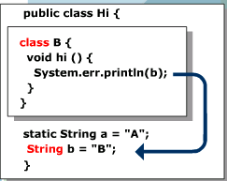
Member Classes
Declare as a member of an outer class.
Can access all fields and methods of the outer class. The reverse is not true.
A member class can be declared as public, protected, private, abstract, final or static

Slide 6
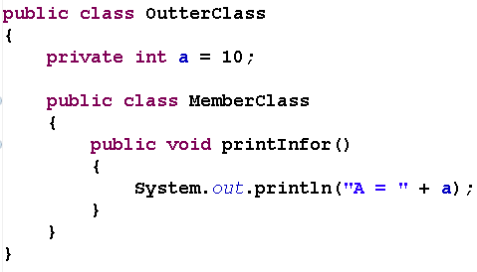


Example of Using Member Class

Slide 7
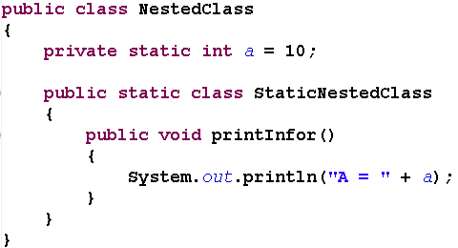
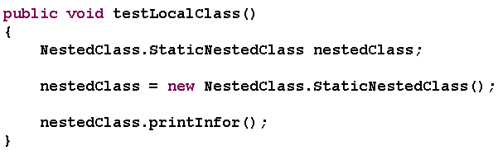
Static Nested Class
Like member class with feature of “static”

Slide 8
Local Classes
Declared within a method, constructor or an initializer
Can access local variable, method parameters, or exception parameters that are in the scope of the local method definition, provided that these are declare as “final”
Cannot use modifiers “public”, “private”, “protected” or “static” in local class
Only “final” or “abstract” is permitted
Can access any members, including private members, of the containing class.

Slide 9

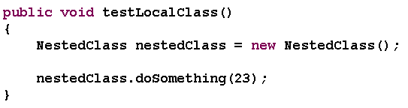
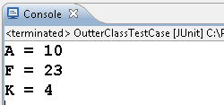
Example of Using Local Class

Slide 10
Anonymous Classes
Class does not have a name.
It is a type of local class.
Does not allow the use of “extends”, “implements” clauses.
Does not allow the use of “private”, “public”, “protected” and “static”
Cannot define a constructor.
Cannot define any static fields, methods or classes.

Slide 11

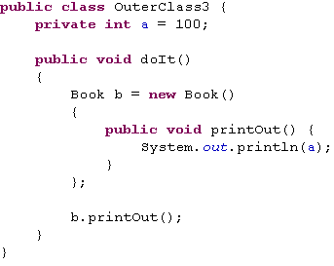
Example of Using Anonymous Classes

Slide 12
That’s all for today!
Member class or non-static nested classes
Static Nested classes
Local classes
Anonymous classes
Thank you all for your attention and patient !

